Slide 1
Natural Language Processing

Slide 2
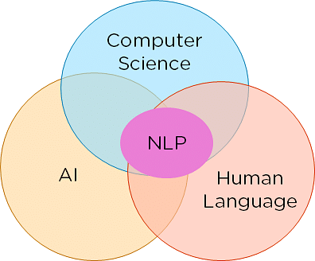
Natural Language Processing
Natural language processing studies interactions between humans and computers to find ways for computers to process written and spoken words similar to how humans do. The field blends computer science, linguistics, and machine learning.
The goal of NLP is to enable computers to understand and interpret human language in a way that is similar to how humans process language.
NLP combines the field of linguistics and computer science to decipher language structure and guidelines and to make models which can comprehend, break down and separate significant details from text and speech.

Slide 3
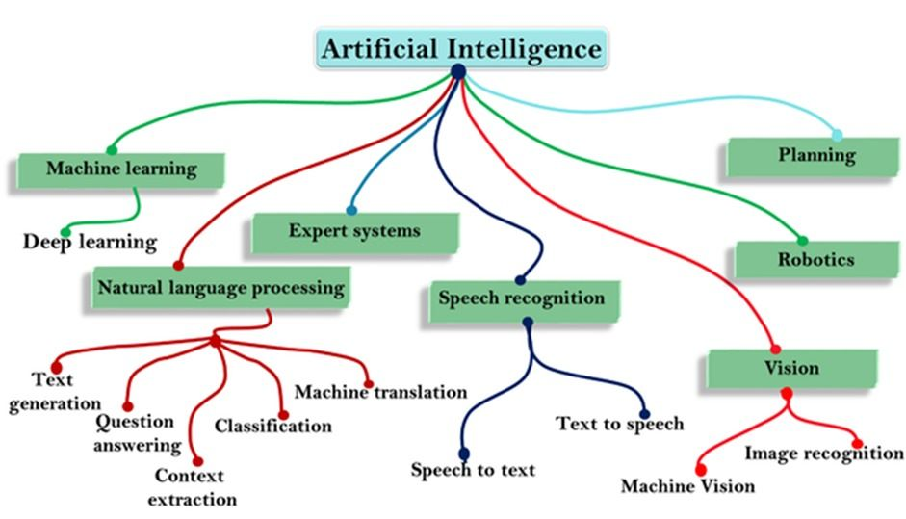
AI and NLP

Slide 4
Why Natural Language Processing is Difficult
We can convey the same meaning in different ways (i.e., speech, gesture, signs, etc.)
The encoding by the human brain is a continuous pattern of activation by which the symbols are transmitted via continuous signals of sound and vision.

Slide 5
Syntactic and Semantic Analysis
Syntactic analysis (syntax) and semantic analysis (semantic) are the two primary techniques that lead to the understanding of natural language.
The syntax is the grammatical structure of the text, whereas semantics is the meaning being conveyed.
A syntactically correct sentence, however, is not always semantically correct. For example, “cows flow supremely” is grammatically valid (subject—verb — adverb) but it doesn’t make any sense.
Syntactic analysis, also referred to as syntax analysis or parsing, is the process of analyzing natural language with the rules of a formal grammar.

Slide 6
Syntactic and Semantic Analysis
The way we understand what someone has said is an unconscious process relying on our intuition and knowledge about language itself.
Semantic analysis is the process of understanding the meaning and interpretation of words, signs, and sentence structure. This lets computers partly understand natural language the way humans do.
I say this partly because semantic analysis is one of the toughest parts of natural language processing and it’s not fully solved yet.

Slide 7
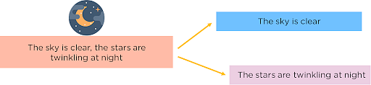
Different Parts of NLP
Segmentation:
To break the entire document down into its constituent sentences. You can do this by segmenting the article along with its punctuations like full stops and commas.

Slide 8
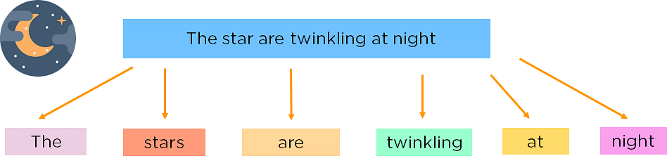
Tokenizing:
To understand these sentences, you need to get the words in a sentence and explain them individually. So, you break down your sentence into its constituent words and store them. This is called tokenizing, and each world is called a token.

Slide 9
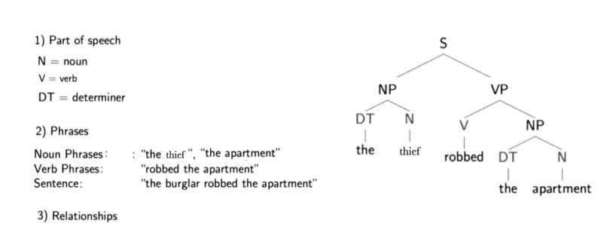
PARSING
According to the dictionary, to parse is to “resolve a sentence into its component parts and describe their syntactic roles.
Parsing is the process of analyzing the grammatical structure of a sentence to determine its syntactic and semantic meaning.
Parsing refers to the formal analysis of a sentence by a computer into its constituents, which results in a parse tree showing their syntactic relation to one another in visual form, which can be used for further processing and understanding.
In essence, tokenizing deals with segmentation, while parsing deals with the syntactic and semantic structure of the segmented units.
Below is a parse tree for the sentence “The thief robbed the apartment.”

Slide 10
PARSING
Noun phrases are one or more words that contain a noun and maybe some descriptors, verbs or adverbs. The idea is to group nouns with words that are in relation to them.
A parse tree also provides us with information about the grammatical relationships of the words due to the structure of their representation. For example, we can see in the structure that “the thief” is the subject of “robbed.
With structure I mean that we have the verb (“robbed”), which is marked with a “V” above it and a “VP” above that, which is linked with a “S” to the subject (“the thief”), which has a “NP” above it. This is like a template for a subject-verb relationship and there are many others for other types of relationships.

Slide 11
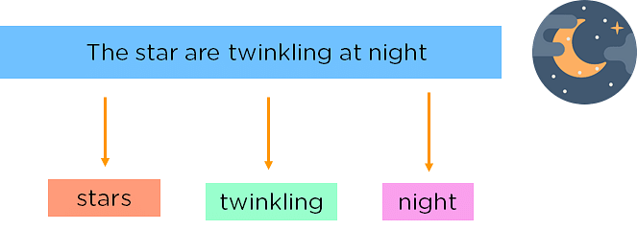
Removing Stop Words
Words such as was, in, is, and, the, are called stop words and can be removed.

Slide 12
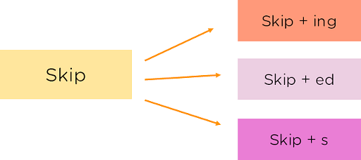
STEMMING
Stemming is the process of reducing words to their word stem. A “stem” is the part of a word that remains after the removal of all affixes. For example, the stem for the word “touched” is “touch.” “Touch” is also the stem of “touching,” and so on.
Popular algorithms for stemming include the Porter stemming algorithm from 1979, which still works well.

Slide 13
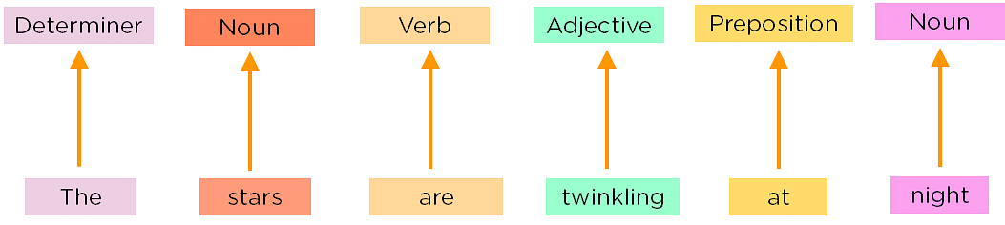
Part of Speech Tagging

Slide 14
NAMED ENTITY RECOGNITION
Named entity recognition (NER) concentrates on determining which items in a text (i.e. the “named entities”) can be located and classified into predefined categories. These categories can range from the names of persons, organizations, and locations to monetary values and percentages.
For example:
Before NER: Martin bought 300 shares of SAP in 2016.
After NER: [Martin]Person bought 300 shares of [SAP]Organization in [2016]Time.

Slide 15
SENTIMENT ANALYSIS
With sentiment analysis, we want to determine the attitude (i.e. the sentiment) of a speaker or writer concerning a document, interaction or event.
Therefore it is a natural language processing problem where text needs to be understood to predict the underlying intent.
The sentiment is mostly categorized into positive, negative, and neutral categories.
With the use of sentiment analysis, for example, we may want to predict a customer’s opinion and attitude about a product based on a review they wrote.
Sentiment analysis is widely applied to reviews, surveys, documents and much more.

Slide 16
Applications of NLP
Translation Tools
Chatbots, CUSTOMER SERVICE, HEALTHCARE
Text summarization:
Targeted Advertising, MARKETING
Autocorrect:
CYBERSECURITY
Social media sentiment analysis:

Slide 17
Machine Learning and NLP
ML can be applied in NLP technology. But there are several types of NLP that function without relying on AI or ML
When used in natural language processing, machine learning can identify patterns in human speech, understand sentient context, pick up contextual clues, and learn any other component of the text or voice input.
Machine learning for NLP encompasses a series of arithmetical systems to identify different sections of speech, sentiment, entities, and other text aspects.

Slide 18
Supervised machine learning for NLP
In supervised ML, a huge amount of text is annotated or tagged with samples of what the system should look for as well as how it should interpret it.
These texts are used to teach a statistical model that is assigned un-tagged text to examine.
For instance, you can utilize supervised machine learning to train a specific model to examine film or TV show reviews and later teach it to incorporate the star rating of each reviewer.

Slide 19
Unsupervised machine learning for NLP
Unsupervised machine learning involves training a particular model without annotating or pre-tagging. This type of ML can be tricky but it is far less data- and labor-intensive compared to supervised ML.
Clustering means grouping similar documents together into groups or sets. These clusters are then sorted based on importance and relevancy (hierarchical clustering).
Another type of unsupervised learning is Latent Semantic Indexing (LSI). This technique identifies on words and phrases that frequently occur with each other.
Matrix factorization is a mathematical technique used for extracting meaningful representations of words, documents, or other textual elements by decomposing large matrices into lower-dimensional matrices. The primary goal is to capture latent semantic relationships between words or documents, facilitating various NLP tasks.
Important Python libraries for NLP
Natural Language Toolkit (NLTK)
spaCy
TextBlob
CoreNLP

Slide 20
Deep learning NLP Techniques
Convolutional Neural Network (CNN): The idea of using a CNN to classify text was first presented in the paper “Convolutional Neural Networks for Sentence Classification” by Yoon Kim. The central intuition is to see a document as an image. However, instead of pixels, the input is sentences or documents represented as a matrix of words.
Recurrent Neural Network (RNN)
Autoencoders
Encoder-decoder sequence-to-sequence
Transformers

Slide 21
Some Important Points
Preprocessing: Before applying NLP techniques, it is essential to preprocess the text data by cleaning, tokenizing, and normalizing it.
Feature Extraction: Feature extraction is the process of representing the text data as a set of features that can be used in machine learning models.
Word Embeddings: Word embeddings are a type of feature representation that captures the semantic meaning of words in a high-dimensional space.
Neural Networks: Deep learning models, such as neural networks, have shown promising results in NLP tasks, such as language modeling, sentiment analysis, and machine translation.
Evaluation Metrics: It is important to use appropriate evaluation metrics for NLP tasks, such as accuracy, precision, recall, F1 score, and perplexity.

